Slide 1
Text-to-Animation User Guide

Slide 2
Install
GCP
Rhubarb
Virtual environment
使用流程

Slide 3
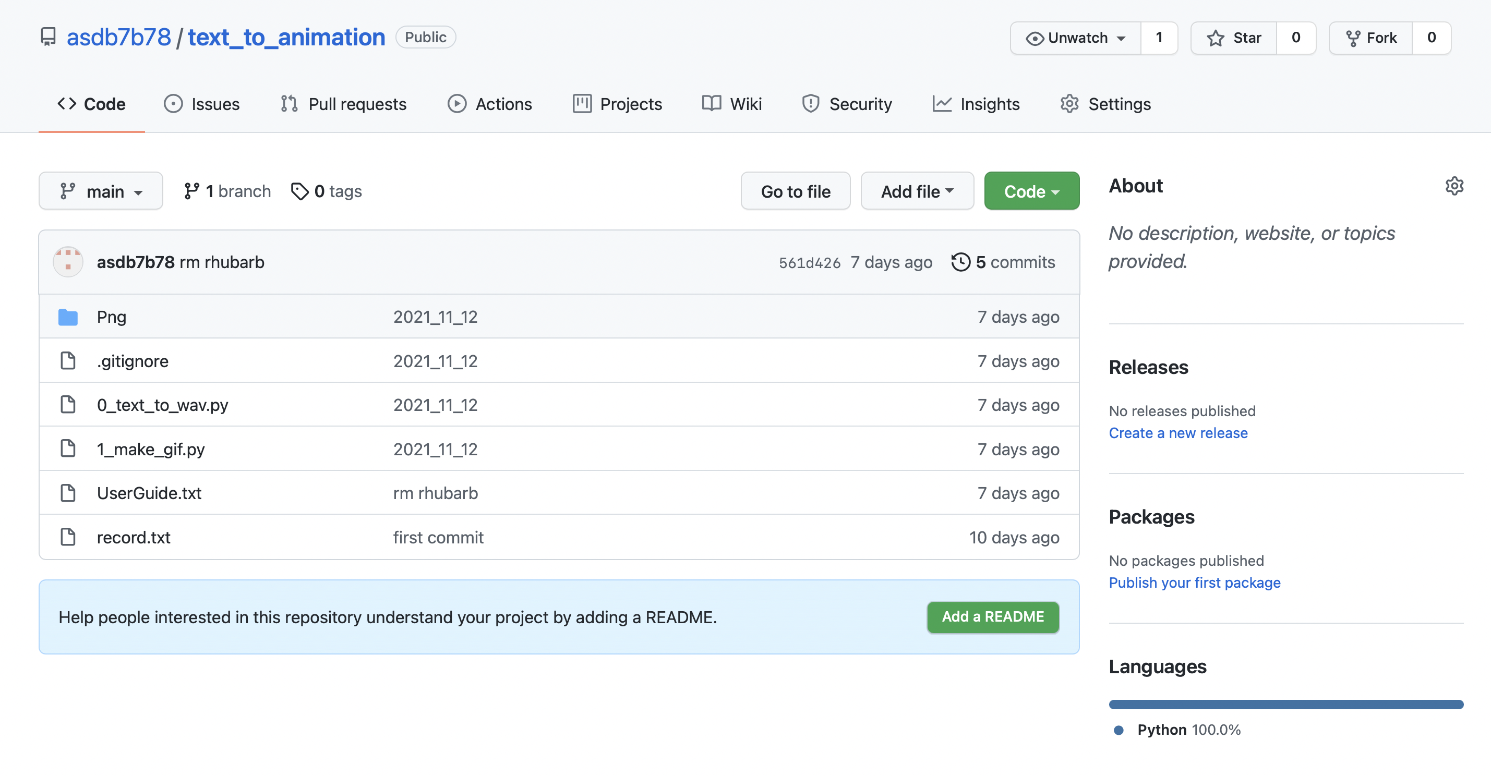
Install
Download from github: https://github.com/asdb7b78/text_to_animation

Slide 4
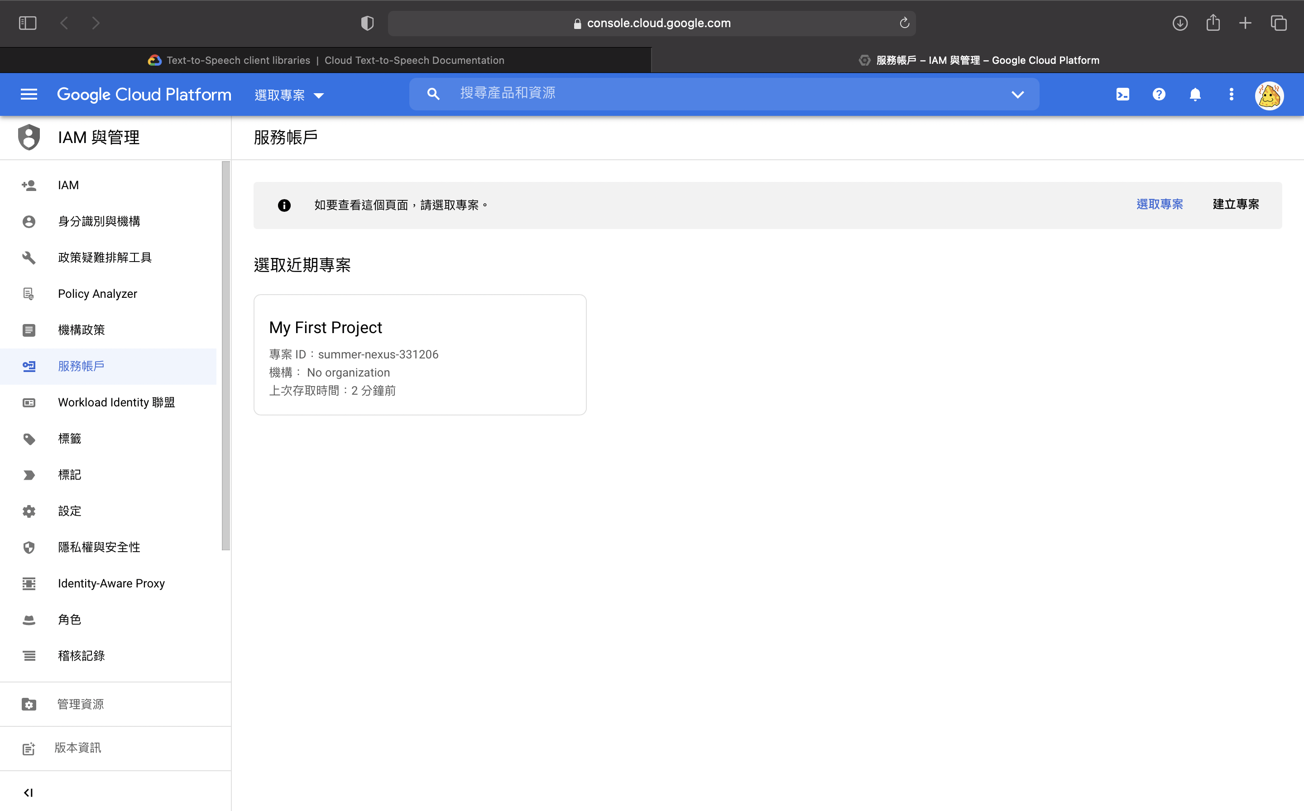
GCP
Setting up authentication，到Google Cloud Platform 建立專案和服務帳戶並啟用text to speech api。https://cloud.google.com/text-to-speech/docs/libraries
2
1

Slide 5
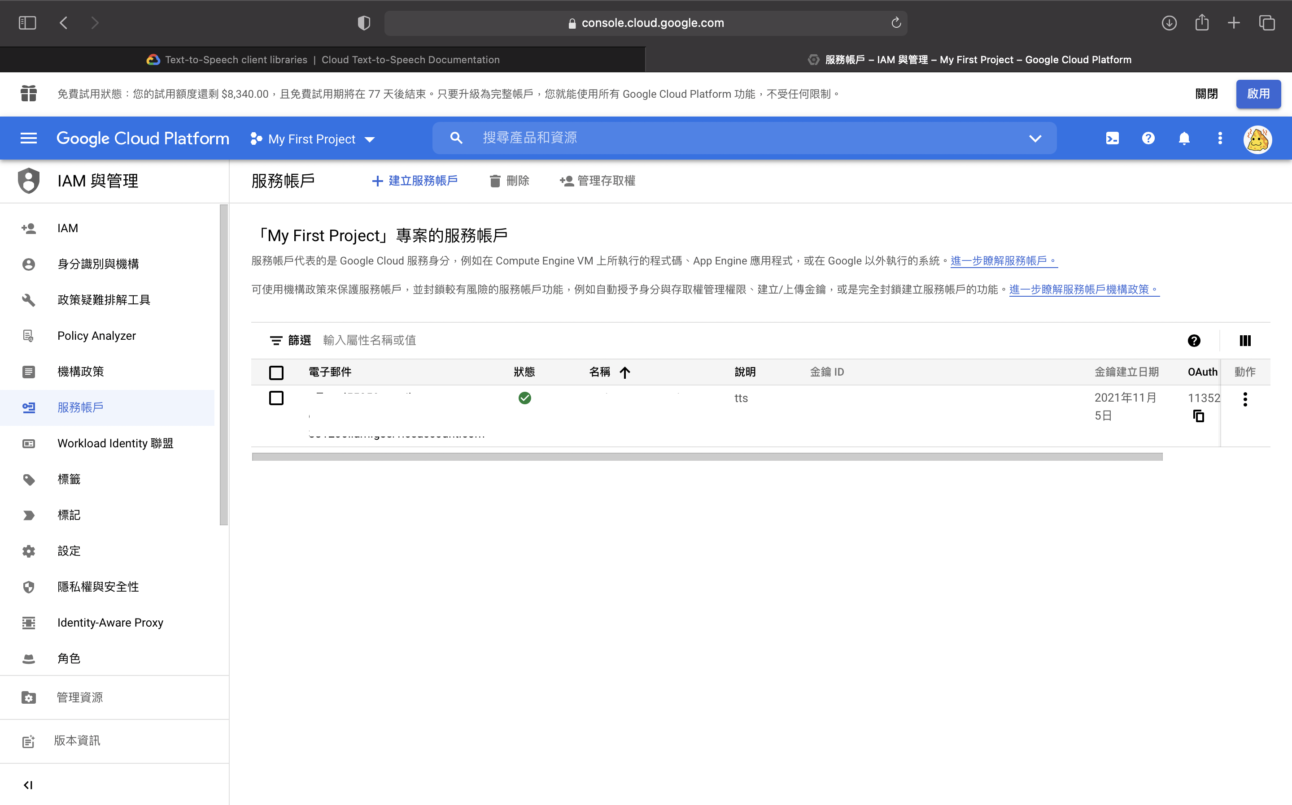
3
4

Slide 6
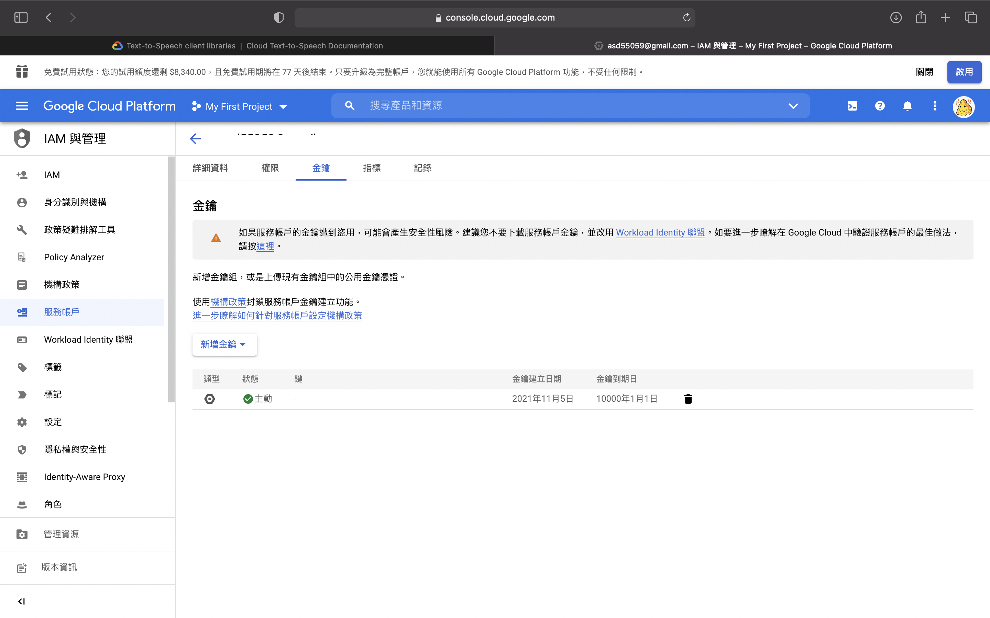
5
6

Slide 7
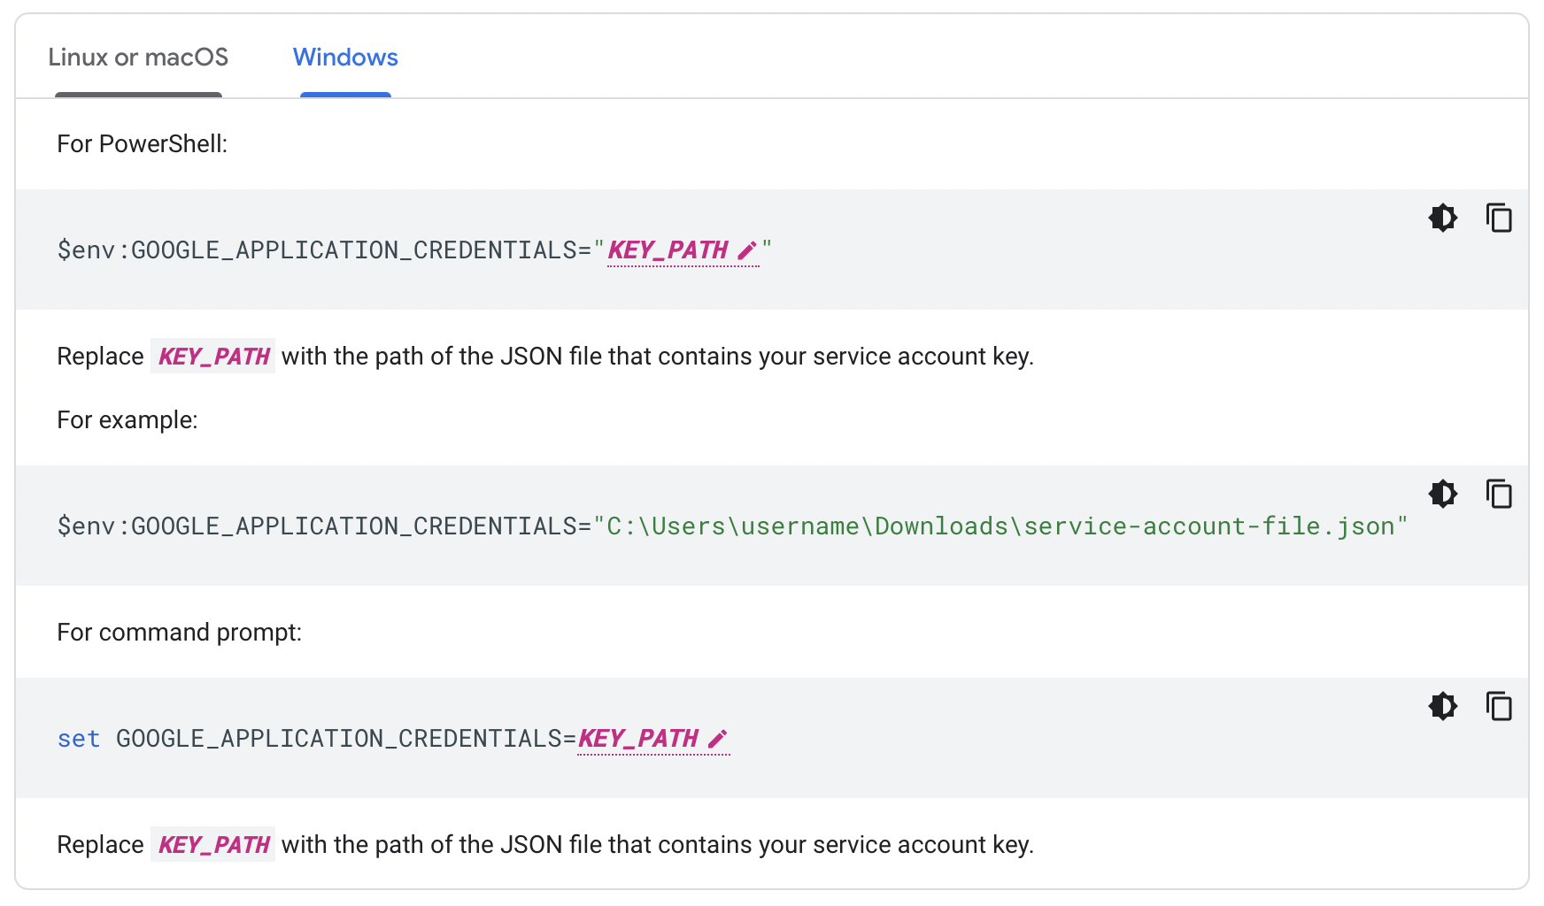
將生成的 .json key 下載後將環境變數GOOGLE_APPLICATION_CREDENTIALS設為key的檔案路徑。

Slide 8
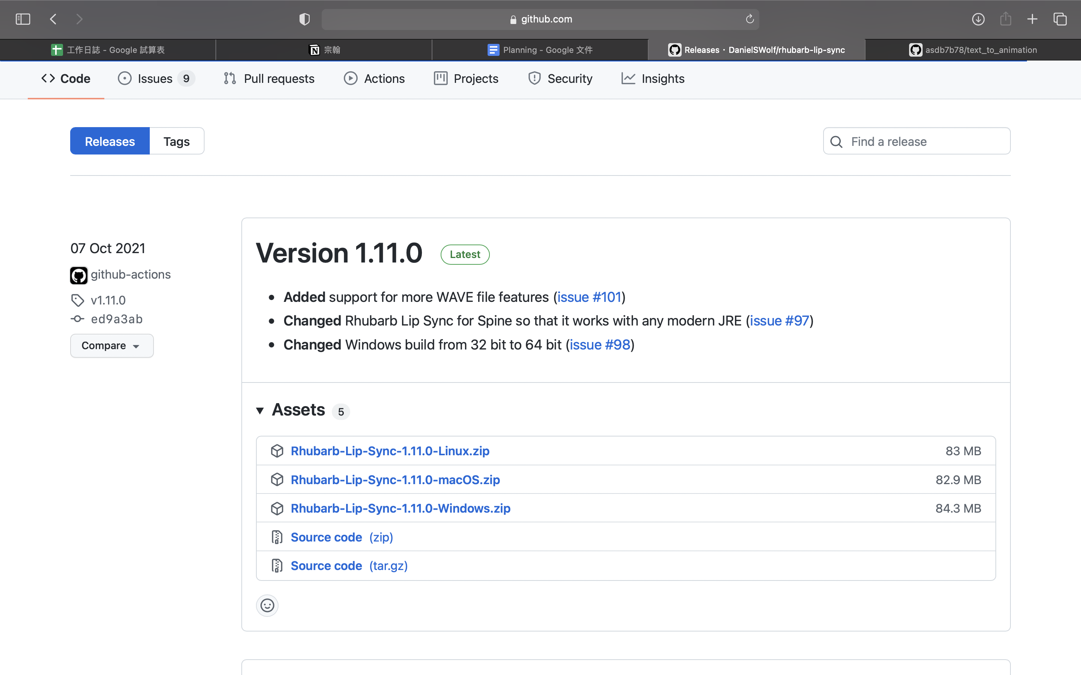
Rhubarb
Download: https://github.com/DanielSWolf/rhubarb-lip-sync/releases

Slide 9
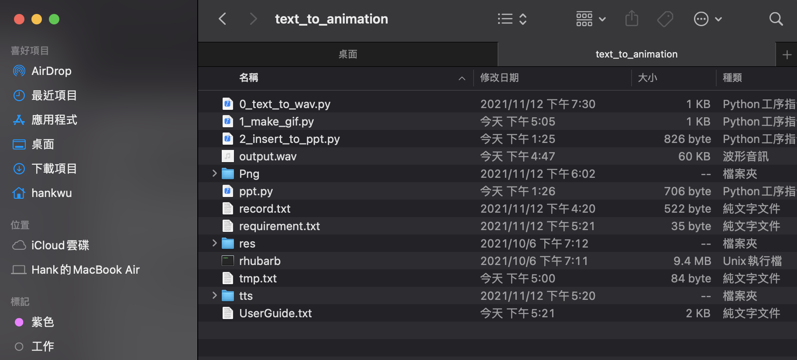
將'res'資料夾和'rhubarb.exe'(或'rhubarb')放入'text_to_animation'

Slide 10
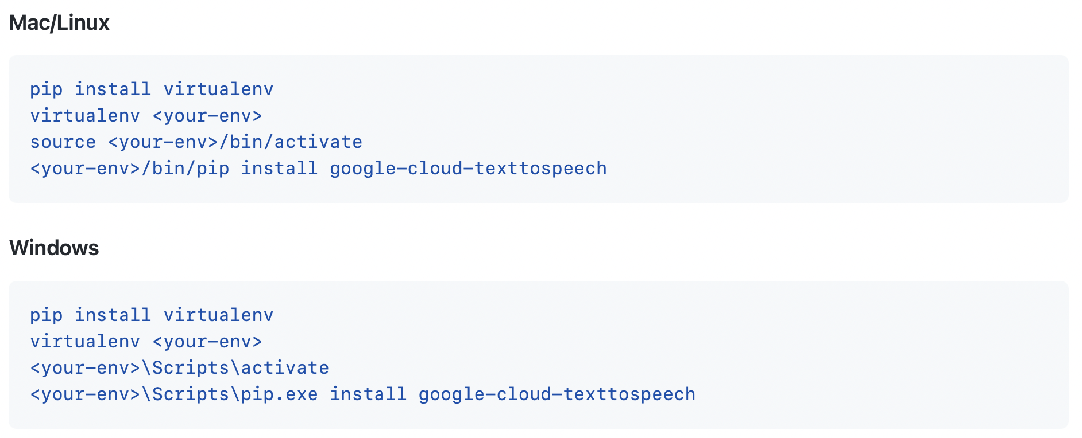
Set up virtual environment

Slide 11
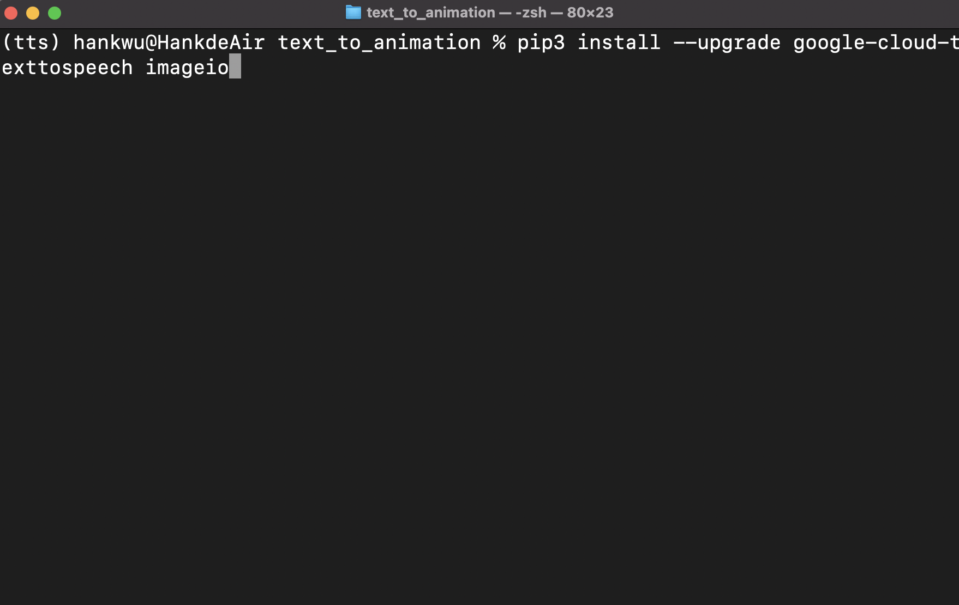
Install Python package in virtual env
Command: 'pip3 install --upgrade google-cloud-texttospeech imageio'

Slide 12
使用流程
Rhubarb
1_text_to_wav.py
Text
Input
Wav
mouth.txt
3_insert_to_ppt.py
2_make_gif.py
Pptx
Gif
source
pptx
source
PNG

Slide 13
使用流程
0_pptx_to_text.py
1_text_to_wav.py
source
pptx
text.txt
Wav
Rhubarb
2_make_gif.py
3_insert_to_ppt.py
mouth.txt
Gif
source
PNG
Pptx

